Slide 1
WELCOME TO OUR PRESENTATION
PRESENTATION TOPIC : How to make a result sheet in Microsoft Excel.

Slide 2
Group name:A
Course instructor
Presented by
Md:Mahbub-E-Noor
Assistant Professor
Department of Computer Science and Engineering
University Of Barishal
Name:Ashikuz Zaman
Roll :18
Department:philosophy
Name: Subir biswas
Roll:25

Slide 3
CONCEPTS TO BE DISCUSSED
Conditional formula
How to make result sheet in Excel with formula
How the formula is applied to the Grade
How the formula is applied to the GPA
How the formula is applied to the Total GPA
How the formula is applied to the Average GPA
How the formula is applied to the Total grade

Slide 4
Conditional formula
Conditional formulas are an extremely powerful feature of Excel that allow you to make calculations dynamic. These formulas can be used to check the value of a cell and take action based on the result.

Slide 5
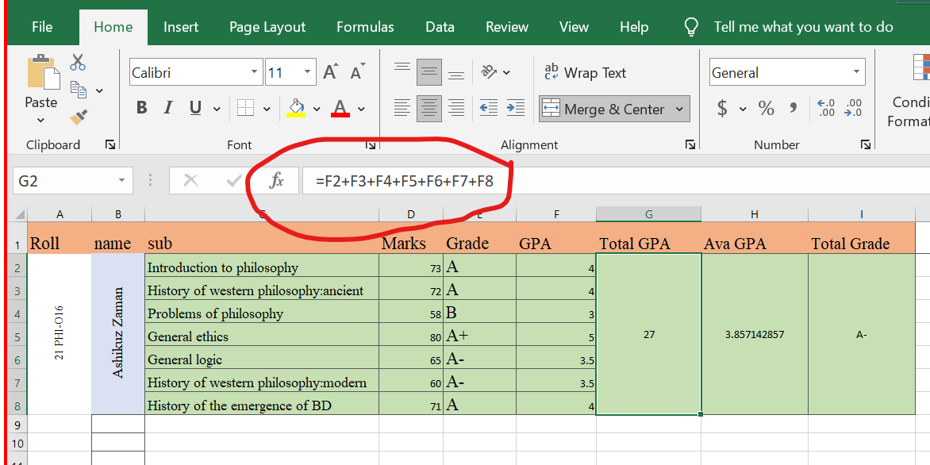
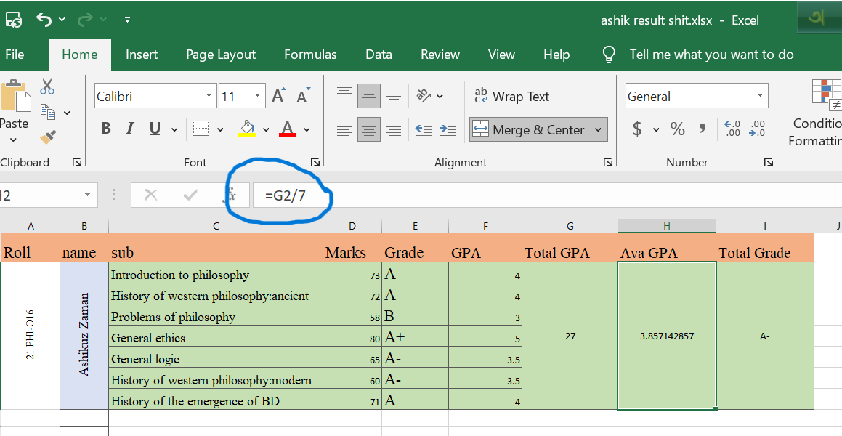
How to make result sheet in Excel with formula
For simple formulas, simply type the equal sign followed by the numeric values that i want to calculate and the math operators that I want to use - the plus sign (+) to add, the minus sign (-) to subtract, the asterisk (*) to multiply, and the slash (/) to divide. Vertical sign ‘’ to (word/latter) explain…….

Slide 6
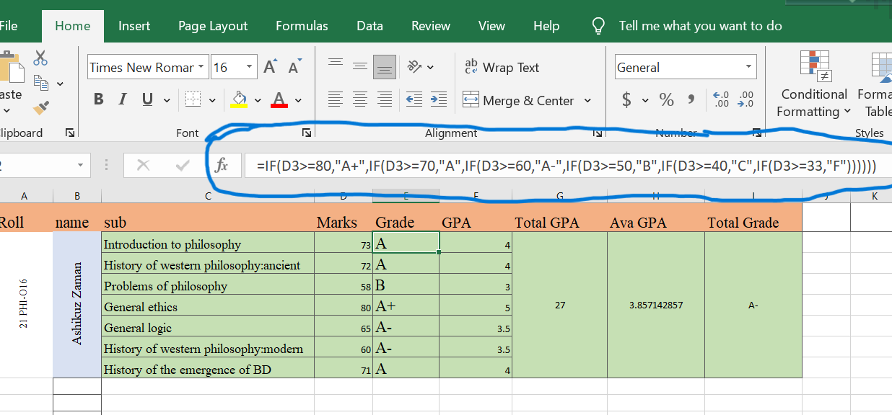
How the formula is applied to the Grade

Slide 7
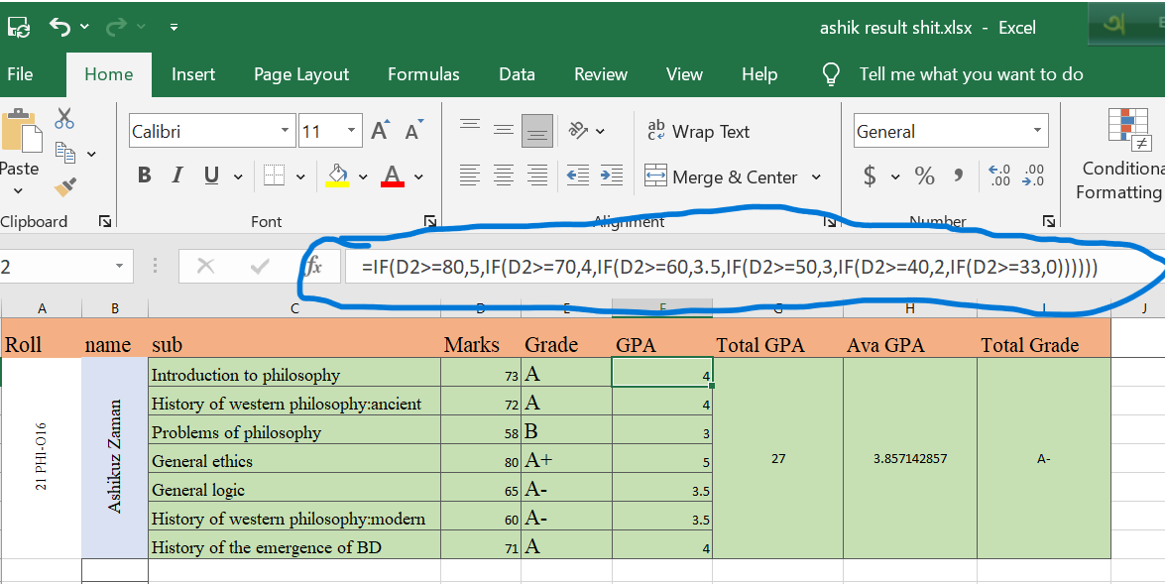
How the formula is applied to the GPA

Slide 8
How the formula is applied to the Total GPA

Slide 9
How the formula is applied to the Average GPA

Slide 10
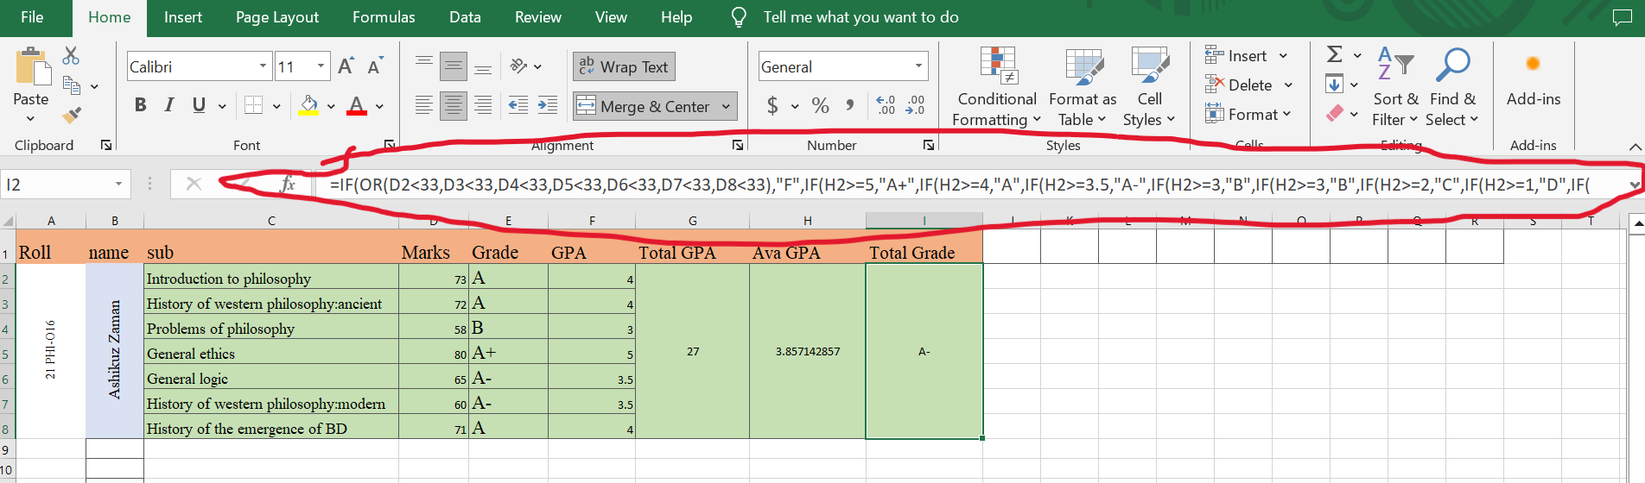
How the formula is applied to the Total grade

Slide 11
THANK YOU

